Slide 1


K.RAMAKRISHNAN COLLEGE OF TECHNOLOGY (AUTONOMOUS), TRICHY
Splitting a Sales Dataset into Monthly Subsets Using tidyr
PRESENTED BY
NEHA HENIN J –2303811714822025
02.06.2025
01

Slide 2
PRESENTATION OVERVIEW
Objective
Problem statement
Existing system and its drawback
Proposed system and advantages
Block diagram
Dataflow diagram
Module split-up
Module explanation
Screenshot
02.06.2025
02

Slide 3
OBJECTIVE
To demonstrate how to effectively split a large sales dataset into monthly subsets using the tidyr package in R.
02.06.2025
03

Slide 4
PROBLEM STATEMENT
Large sales datasets are often hard to analyze in bulk.
Manual splitting is time-consuming and error-prone.
Lack of dynamic and automated data separation methods hampers data exploration.
02.06.2025
04

Slide 5
  EXISTING SYSTEM AND ITS DRAWBACK
EXISTING SYSTEM:
Manual Filtering or Excel-Based Splitting:
The current system for splitting attendance or time-series data by month is largely manual and Excel-based.
This method is labor-intensive, error-prone, and inefficient, particularly for large datasets or repeated monthly tasks.
02.06.2025
05

Slide 6
  EXISTING SYSTEM AND ITS DRAWBACK
DRAWBACK:
Requires significant time and effort.
Prone to human error.
Not scalable for real-time or large datasets.
Repetitive Workflow
Limited Automation
Lack of User Control
02.06.2025
05

Slide 7
PROPOSED SYSTEM & ADVANTAGES
Proposed system:
The proposed system replaces the current manual, Excel-based approach with a fully automated, interactive solution built using R, leveraging the capabilities of the tidyr, lubridate, and shiny packages.
In this system, users can upload raw attendance or time-stamped data in .csv format through a Shiny web interface.
The backend automatically parses and standardizes date formats using lubridate, and then groups and splits the data into monthly subsets using floor_date() and group_split() functions from dplyr.
02.06.2025
06

Slide 8
PROPOSED SYSTEM & ADVANTAGES
Advantages:
Fast and reproducible.
Easy to scale and integrate in pipelines.
Leverages tidyverse best practices.
Ensures consistency and reduces errors.
02.06.2025
06

Slide 9
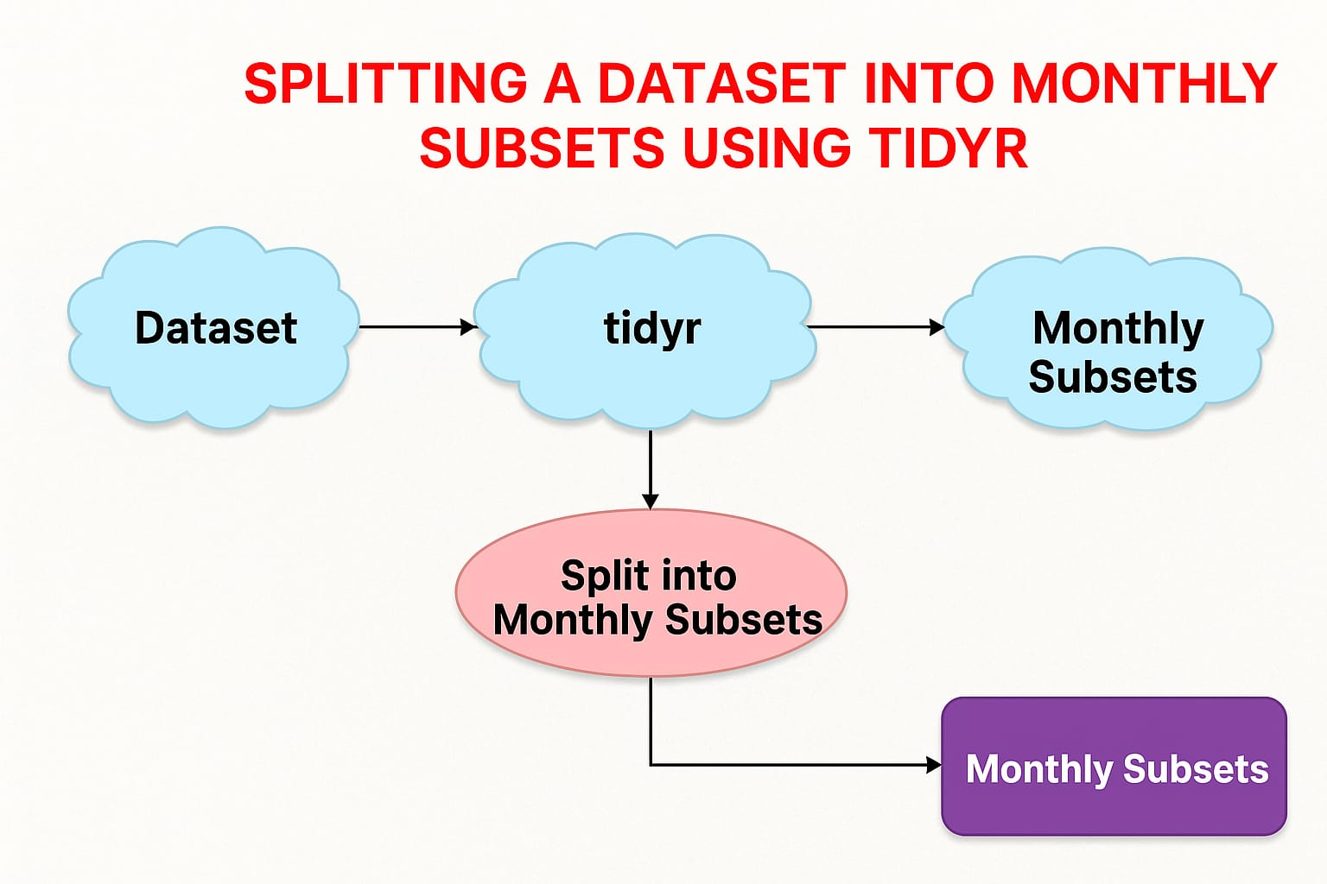
BLOCK DIAGRAM
02.06.2025
07

Slide 10



DATAFLOW DIAGRAM
Import data
Format Date
Create Year-Month Column
Group by Month
Split Dataset
Save/Use each Month
02.06.2025
08

Slide 11
MODULES SPLIT-UP
Data Import
Date Formatting
Month Column Creation
Data Splitting
File Export (Optional)
02.06.2025
09

Slide 12
MODULE EXPLANATION
Data Import : Load data using readr::read_csv().
Date Formatting : Use lubridate to fix date format.
Month Column Creation : Create a new column for Year-Month.
Data Splitting : Use group_by() and group_split().
File Export (Optional) : Export each month's data to a file using a loop.
02.06.2025
10

Slide 13
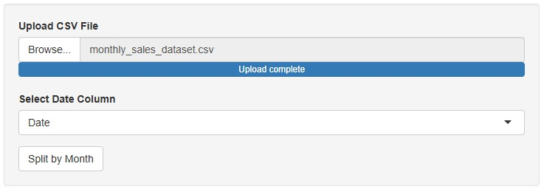
SCREENSHOT
MODULE 1:
02.06.2025
11

Slide 14
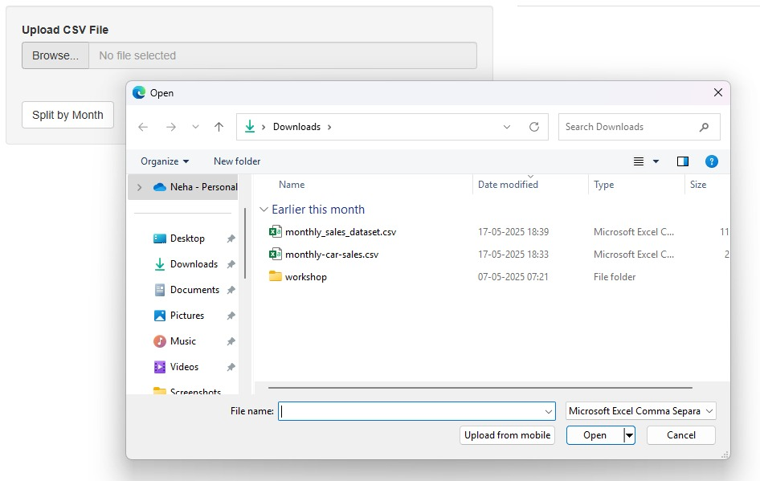
SCREENSHOT
MODULE 2:
02.06.2025
12

Slide 15
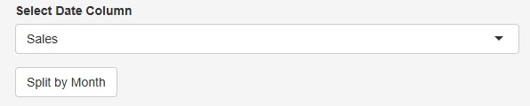
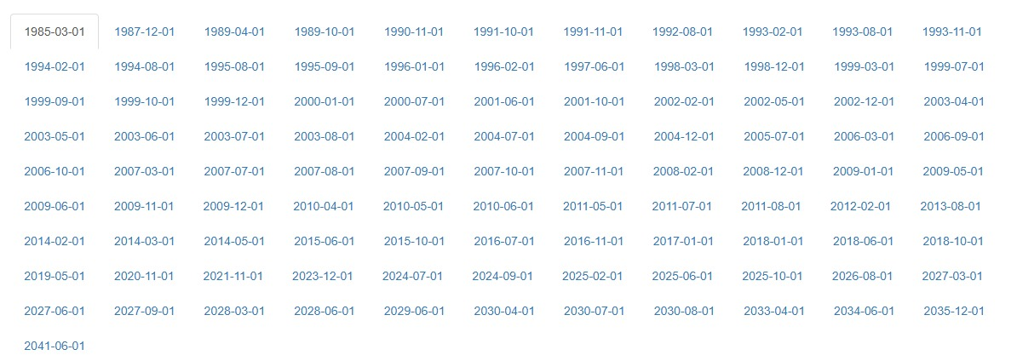
SCREENSHOT
MODULE 3:
MODULE 4:
02.06.2025
14

Slide 16
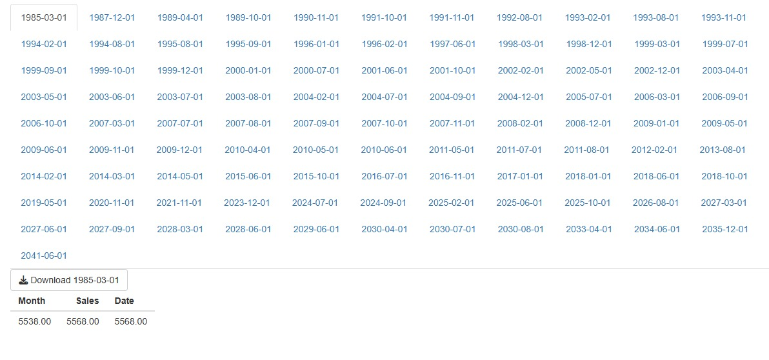
SCREENSHOT
MODULE 5:
02.06.2025
15

Slide 17
CONCLUSION
In conclusion, transitioning from a manual Excel-based workflow to an automated system using R and tidyr significantly enhances the efficiency, accuracy, and scalability of monthly data splitting and analysis.
By eliminating repetitive manual tasks and reducing the risk of human error, this system not only saves time but also ensures consistent and reliable results.
This marks a vital step forward in data management practices, promoting automation, transparency, and data-driven decision-making
02.06.2025
16

Slide 18
THANK YOU!

